Slide 1
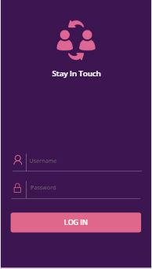
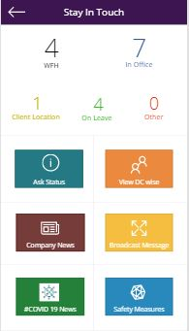
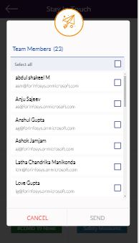
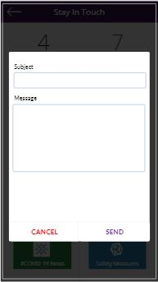
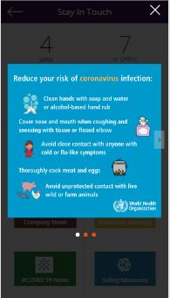
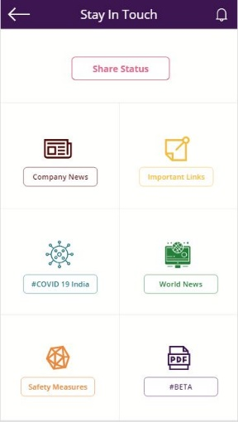
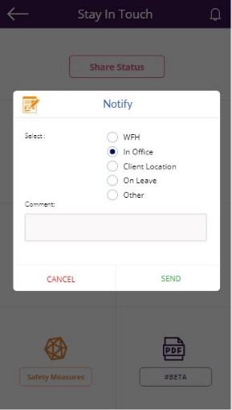
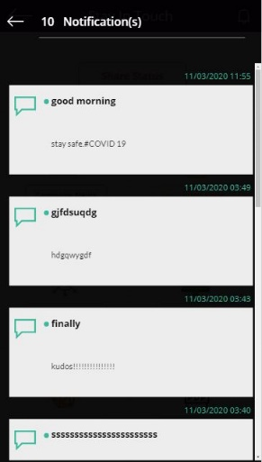
Stay In Touch
Manager Landing Screen
On click of “Send” button a PowerApp push notification is sent to all checked users
This screen allows manager to send a broadcast message or alert to all those reporting him
A horizontal gallery with 3 image slides
Login Screen
Team Member Landing Screen
When user clicks the notification ,the app opens and this popup appears .Also we can open it by clicking “Share Status” button
Here the team member can see all broadcast messages/alerts from the manager for the present day

